Slide 1

ONLINE BANKING SYSTEM
BY:
SANKEERTANA
NIKHITHA
SANDEEP
RAJKUMAR

Slide 2
INTRODUCTION
“Online Banking” refers to a system that enables bank customers to access accounts and general information about all banking services such as transfers, withdrawals, deposits etc., through a personal computer or any smart device.
In our project we aim to create a secure banking system that will be accessible to the users who have a valid user Id and password.

Slide 3
Existing System Vs Proposed System
In the existing system the banking affairs are done manually where people go to the banks to get their transactions done which is a waste of time and energy.
So we created a system which provides all the services for the customers to make any transactions from anywhere only with the touch of a button.

Slide 4
Functional Requirements
There are 2 levels of users in this Application
Customer & Admin
The Customer can:
1. Perform balance enquiry
2. Can edit his own information
3. Request a check book, checks the status
4. Request start payment on check
5. Request stop payment on check

Slide 5
Admin can :
1. Edit the own credentials
2. Edit the customer information
3. Admin can generate reports about all transactions of a customer, transactions by type (deposits, withdraws), view all check book requests, view all customers.
4. Admin can open a customer account and close an account
5. Admin get notifications when customer performs deposits.
6. Admin can review check book requests, can Approve/ Reject the request.
7. Admin can review credit card requests, can Approve/ Reject the request.
8. Admin can view all requests / complaints made by the customers.

Slide 6
Modules
Admin Login
Balance Enquiry
Money Transfer
Customer Register
Customer Login
Account History

Slide 7
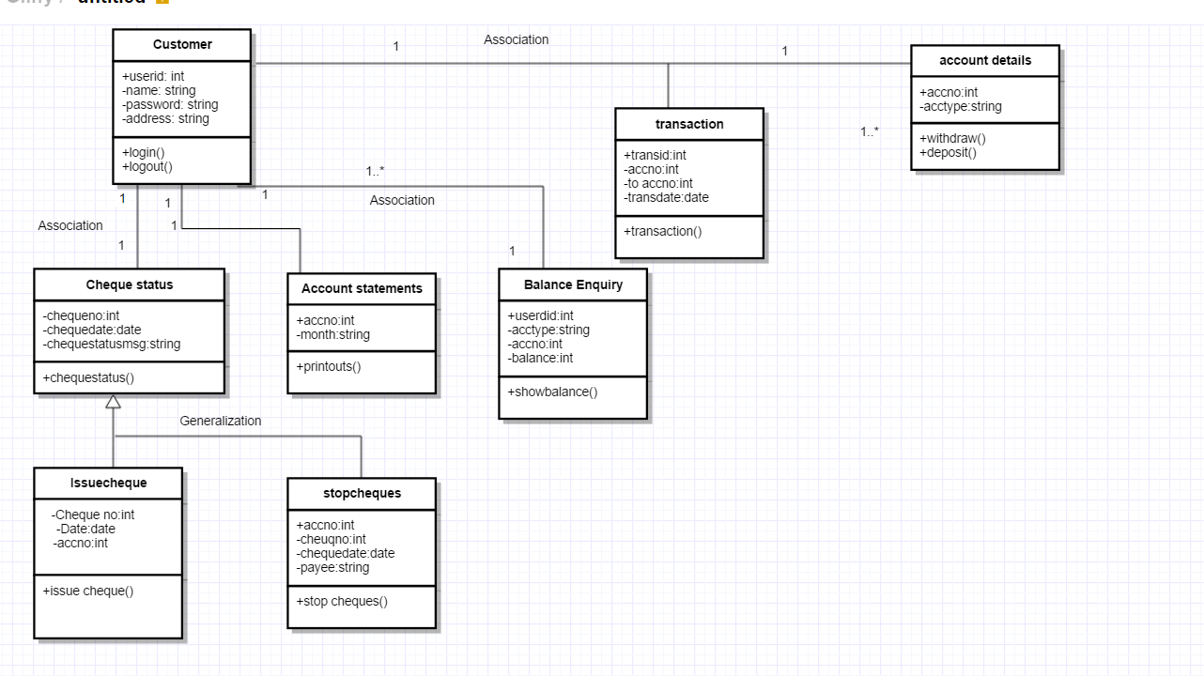
CLASS DIAGRAM

Slide 8
System Requirements
Software Requirement :
Operating System: Windows/Linux/MAC
User Interface: HTML, CSS, JavaScript
Programming Language: PHP
Database: MYSQL
Server: XAMPP(5.6.30) [Any Apache & SQL distributed Environment]
Hardware Requirement:
Processor: Any
Hard Disk: Minimum 10GB
RAM: 256MB or more
Screen : Any

Slide 9
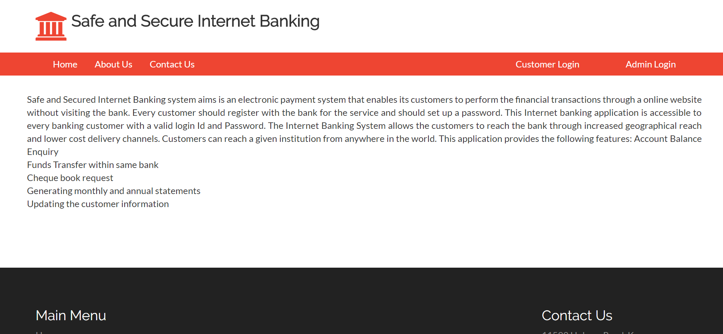
IMPLEMENTATION

Slide 10
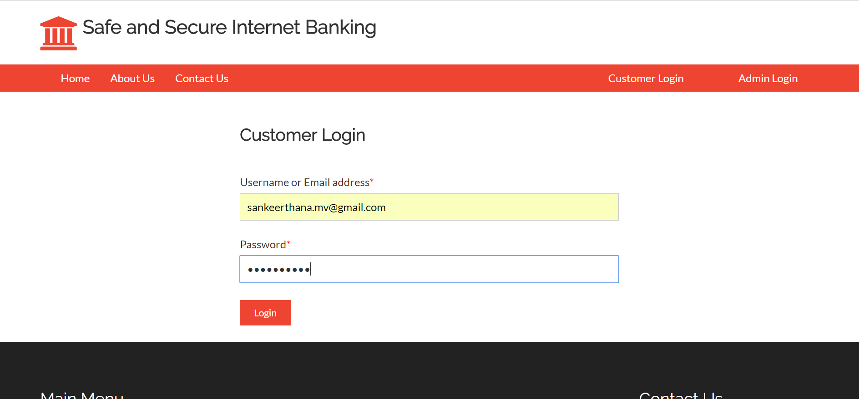
Customer Login

Slide 11
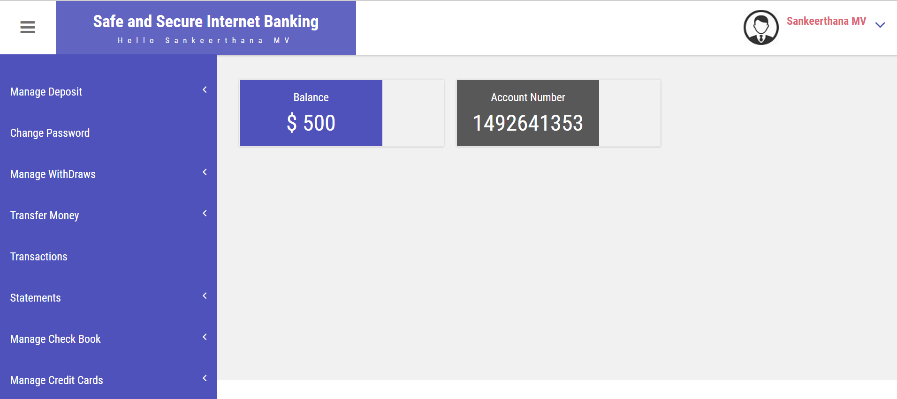
Customer Login

Slide 12
Challenges
Problem: Major challenge faced while handling the transactions. To differentiate among deposit, withdraw and transfer and thus updating the remaining balance.
Solution: Identified the transaction based on to_cust_id and from_cust_id fields.
Problem: Challenge faced while generating transactions statements of the customers.
Solution: Used from and to date formats to calculate transactions for that period of time.
We have used customer user id as his primary key so that various customers with same userid cannot create accounts.

Slide 13
Challenges
We have used different criteria as to change users password for security purpose, where user can only change his password if he enters the old password correctly.
We have used a new functionality called as phpmailer, where user gets notified when he has created an account through a mail.

Slide 14
Future Enhancements
Text and Email alerts for the transactions
Mobile version of Application

Slide 15
Contribution Report
Name | Module
Sankeertana | Admin Login & operations; PHP
Nikhitha | Front End
Sandeep | Database Creation and Queries
Rajkumar | Customer login & operations; PHP

Slide 16


